Slide 1

Human Mobility Prediction in Nagoya, Japan
Alexander Coulter,
Carson James,
Rebecca Lee,
Jiaxin Du

Slide 2
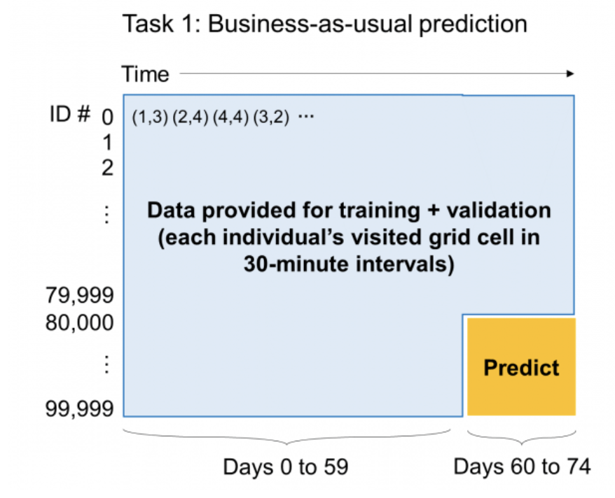

Introduction
The Human Mobility Prediction Challenge 2023 is a competition for predicting human mobility patterns, using an open source, urban scale (100K individuals), longitudinal (75 days) trajectory dataset.¹
Task 1 Dataset:
100,000 people
timestamps of 3600 half hours (75 days)
(x, y) coordinates on 200 x 200 grid
“business as usual”
Aim :
For first 10,000 people, predict last 15 days.
¹ Source : https://connection.mit.edu/humob-challenge-2023

Slide 3
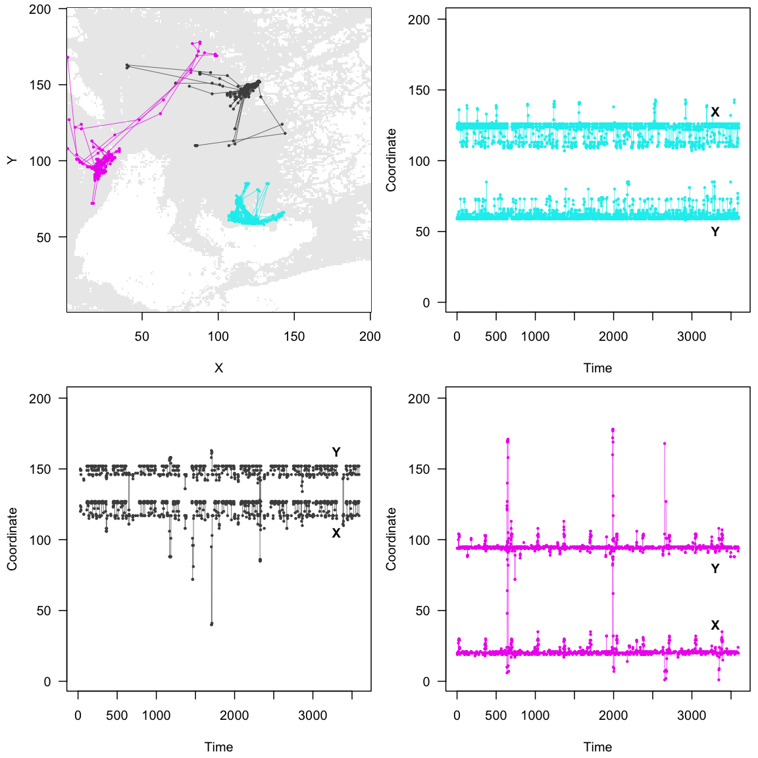
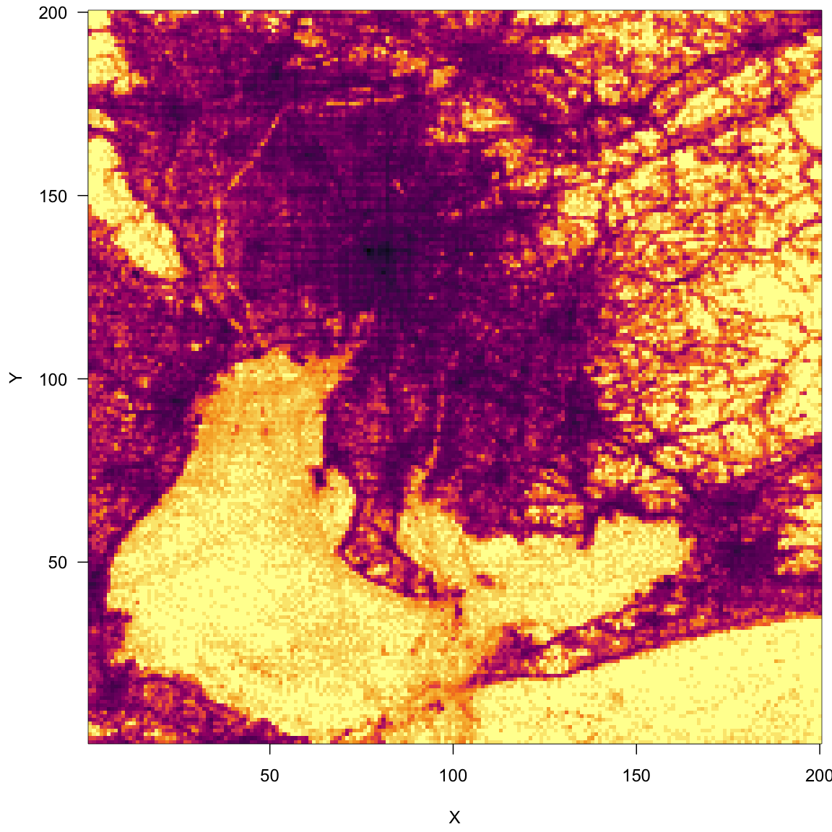
Data Visualization

Slide 4
Baseline Methods
Training Mean
Take average location of first 60 days, use this for prediction
Oracle Mean
Take average location of last 15 days, use this for prediction

Slide 5
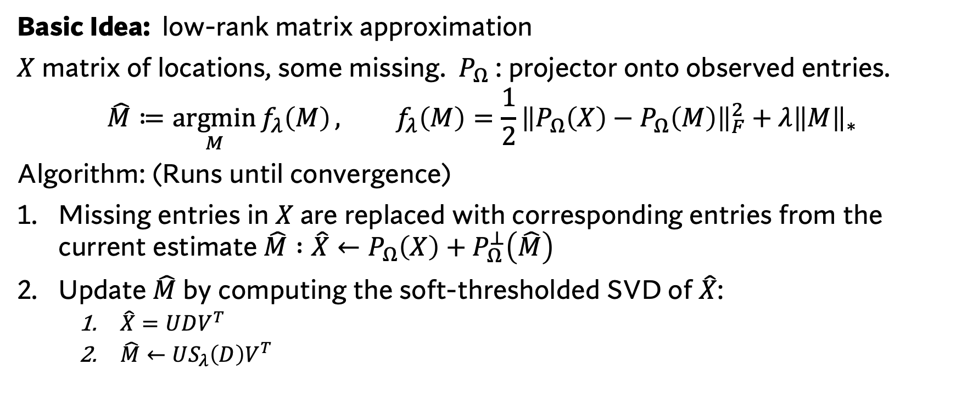
Matrix Completion
Basic Idea: low-rank matrix approximation
$X$ matrix of locations, some missing. $P_{Ω}$ : projector onto observed entries.
$$\hat{M}≔\underset{M}{argmin}{f_{λ}\left(M\right)}, f_{λ}\left(M\right)=\frac{1}{2}{\left\|P_{Ω}\left(X\right)−P_{Ω}\left(M\right)\right\|}_{F}^{2}+λ{\left\|M\right\|}_{∗}$$
Algorithm: (Runs until convergence)
Missing entries in $X$ are replaced with corresponding entries from the current estimate $\hat{M} :\hat{X}←P_{Ω}\left(X\right)+P_{Ω}^{⊥}\left(\hat{M}\right)$
Update $\hat{M}$ by computing the soft-thresholded SVD of $\hat{X}$:
$\hat{X}=UDV^{T}$
$\hat{M}←US_{λ}\left(D\right)V^{T}$

Slide 6
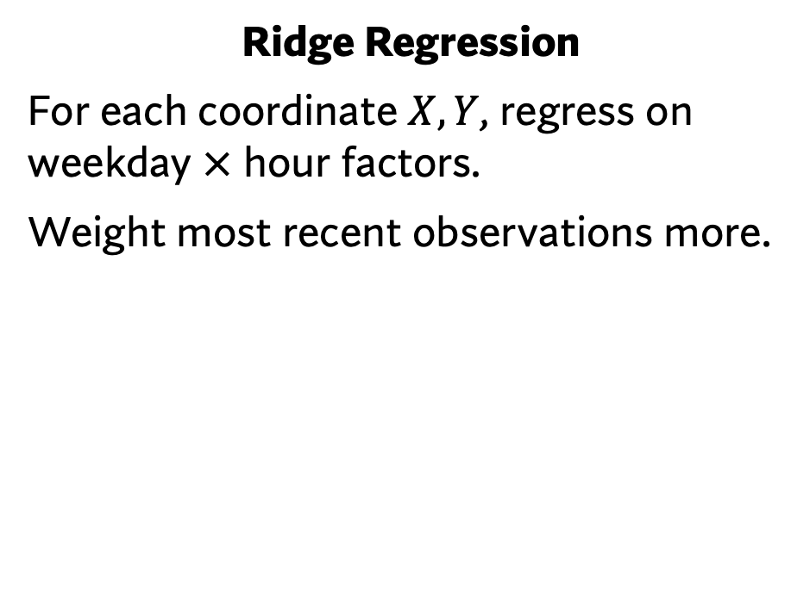
Regression Methods
Ridge Regression
For each coordinate $X, Y$, regress on weekday $×$ hour factors.
Weight most recent observations more.
Multiclass Logistic Regression w/Ridge
2 Step Procedure:
Identify 8 most common visited locations, and re-classifying all locations to those 8 by proximity
Use these 8 locations in multiclass logistic regression w/ridge penalty, same factors & weights.
Both methods: use fitted coefficients to predict into last 15 days

Slide 7
Results

Slide 8
Results

Slide 9
Results

Slide 10
Results

Slide 11
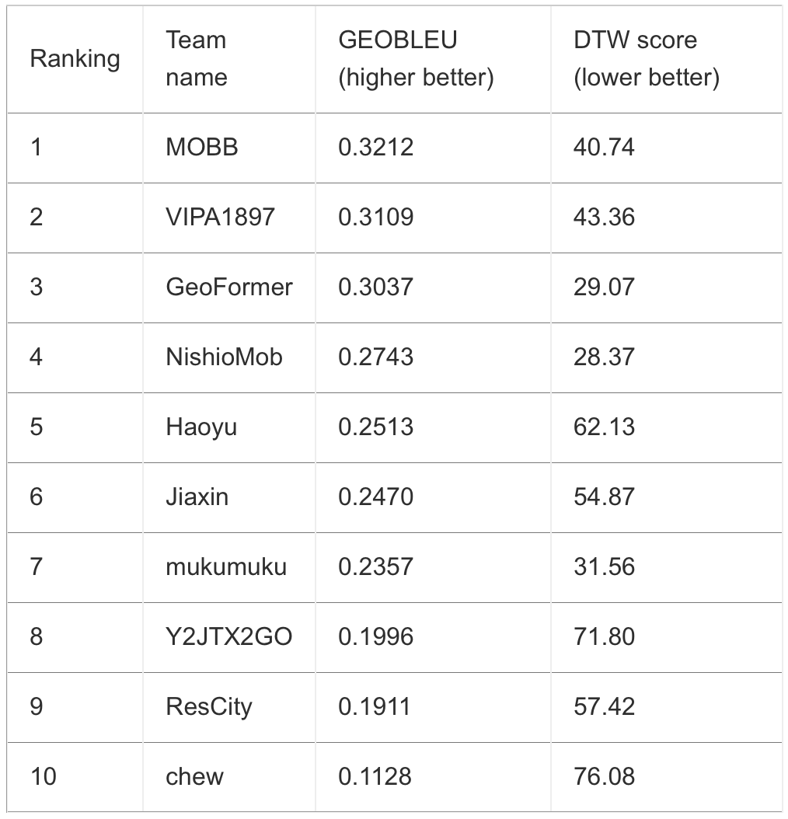
Performance Metrics
Prediction Method | GEO-BLEU | Dynamic Time Warping
Training Mean | 0.0403 | 62.72
Oracle Completion | 0.0429 | 63.77
Matrix Completion | 0.0601 | 69.33
Ridge Regression | 0.1635 | 61.62
Multiclass Logistic Regression w/ Ridge | 0.2280 | 55.63
Table 1: Our Results
Table 2: HuMob Challenge Midterm Results

